Slide 1

New York Mental Health
Group 9
Naman Bareja (NB3236)
Arvind Nagabhirava (AN3317)
Pranav Bidve (PB2972)
Nilaa Raghunathan (NR3005)
Ke Wang (KW3173)
‹#› |

Slide 2
Introduction
Research Question
Can demographic, socioeconomic, and environmental factors accurately predict the prevalence of poor mental health at the neighborhood level?
Project Objectives
Analyze how community-level factors (e.g., income, education, healthcare access, environmental conditions) influence mental health rates across census tracts.
Target Variable (Mental Health): MHLTH
Represents % of adults reporting 14+ days of poor mental health per month.
A key indicator of frequent mental health challenges in the community.
Goals
Identify high-risk areas for poor mental health.
Highlight key community factors associated with mental health outcomes.
‹#› |

Slide 3
Datasets
Following geographical datasets were joined based on latitude and longitude:
Places Data - https://www.cdc.gov/places/about/index.html
40 chronic disease and other measures from US
Reports data at county, place and census tracts
Health facility Information - https://health.data.ny.gov/Health/Health-Facility-General-Information/vn5v-hh5r/about_data
Locations of healthcare facilities like hospitals, nursing homes, diagnostic treatment centres, certified home healthcare agencies, licensed adult care facilities etc.
Smart Location Database - https://www.epa.gov/smartgrowth/smart-location-mapping#SLD
Measures location efficiency with variables like housing density, diversity of land use, neighborhood design etc.
Yelp dataset - not used - NY state not available, explained in further slides.
‹#› |
Notes:
Mention that data is joined across 3 sources using lat/long

Slide 4
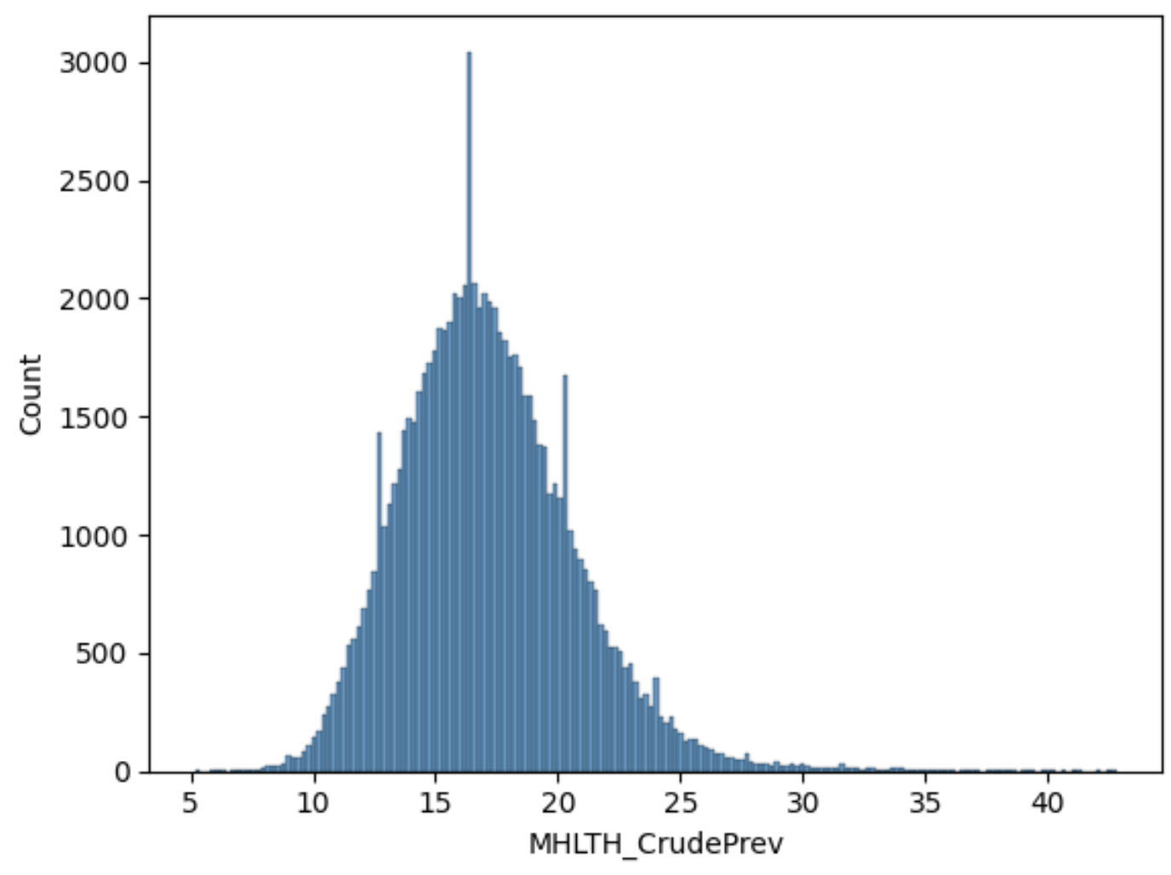
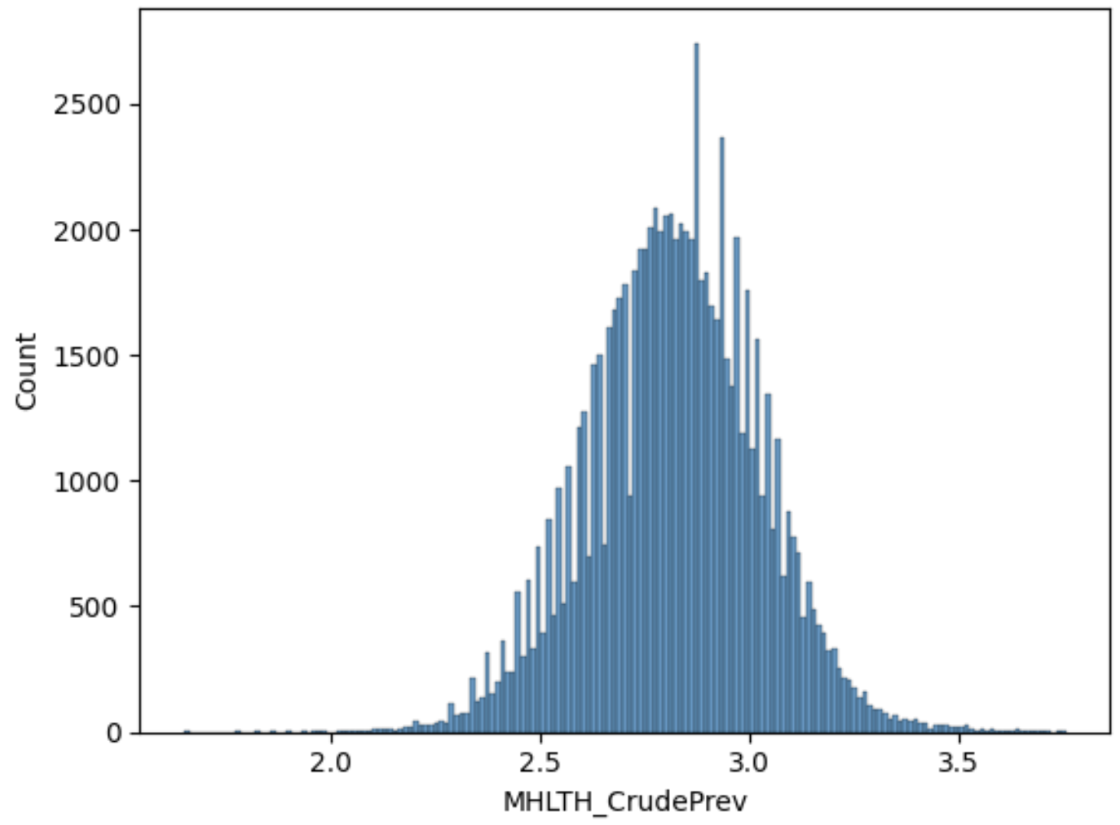
CDC Dataset EDA/Visualizations
Data Wrangling
Data present in two forms - absolute values and 95% Confidence Intervals - retained only the absolute values
Removed columns with over 5% missing values
Pre-processing
Distribution of target variable shown below - as-is and log-transformed (on the right)
Log transformed - appears more symmetric and closer to normal distribution - could improve model stability and reduce impact of extreme values
‹#› |

Slide 5
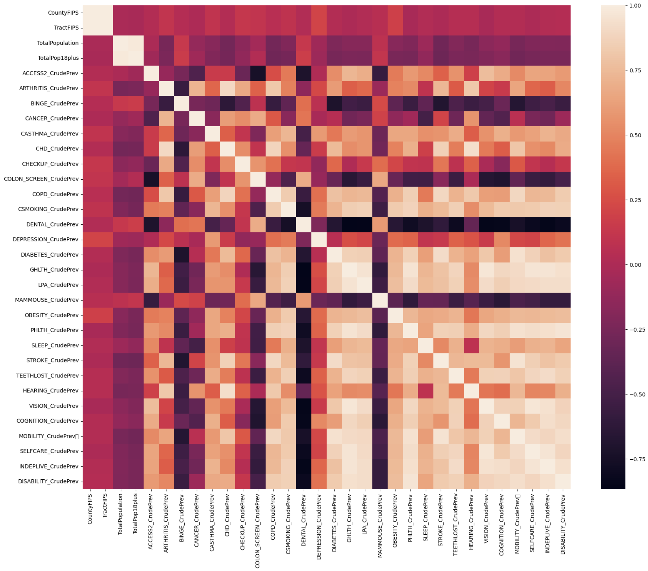
CDC Dataset EDA/Visualizations
Feature Correlation Analysis and Removal of Highly Correlated Features (>80%)
Dropped highly correlated features - 18 features remain
14 features - numerical
Rest - categorical features
Investigating the correlation of variables with target variable : MHLTH_CrudePrev
Positively Correlated | Negatively Correlated | Mixed / Ambiguous Correlation
CASTHMA OBESITY | CANCER DEPRESSION COLON_SCREEN | BINGE (Binge drinking)
‹#› |

Slide 6
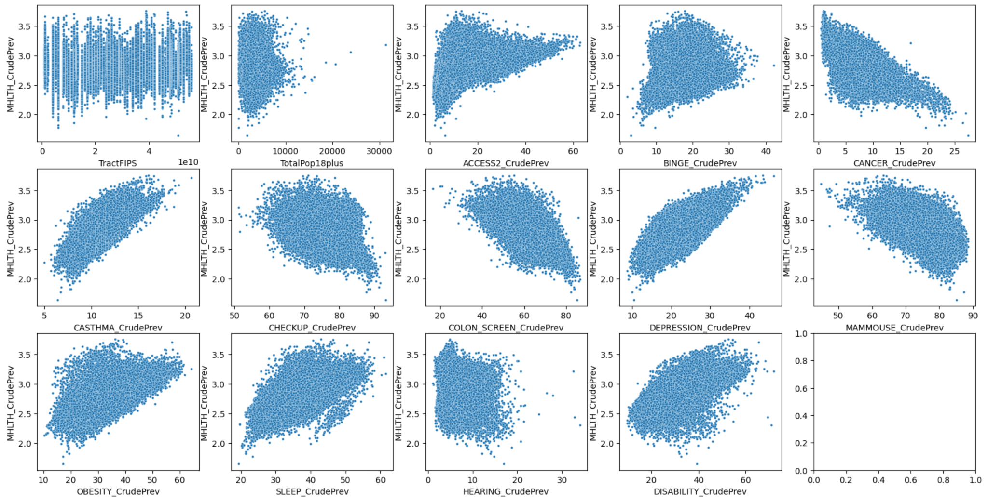
CDC Dataset EDA/Visualizations
Distribution Analysis of Numerical Features vs. Target Variable
‹#› |

Slide 7
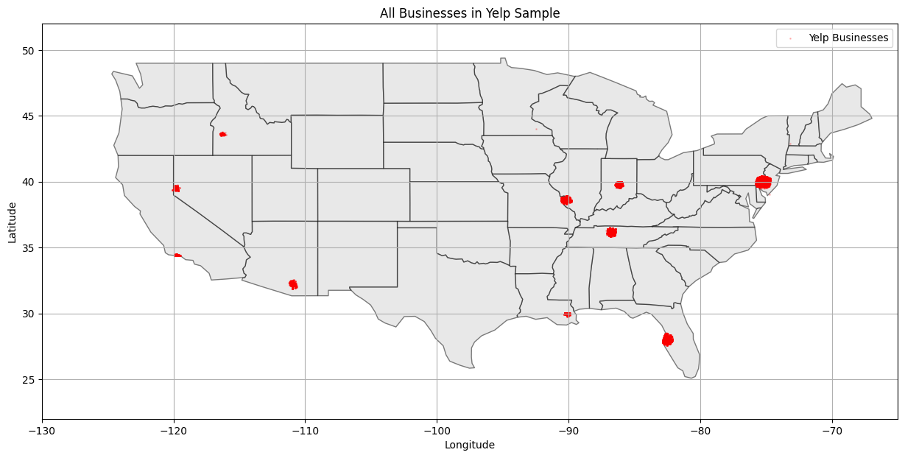
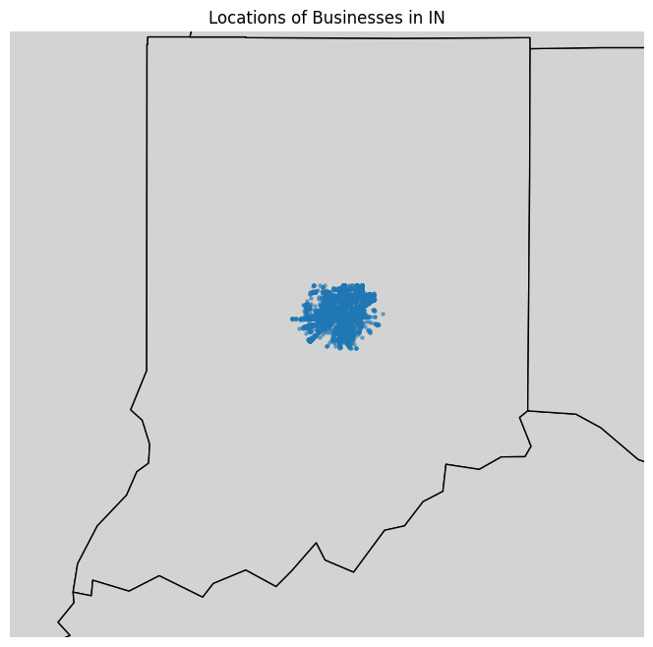
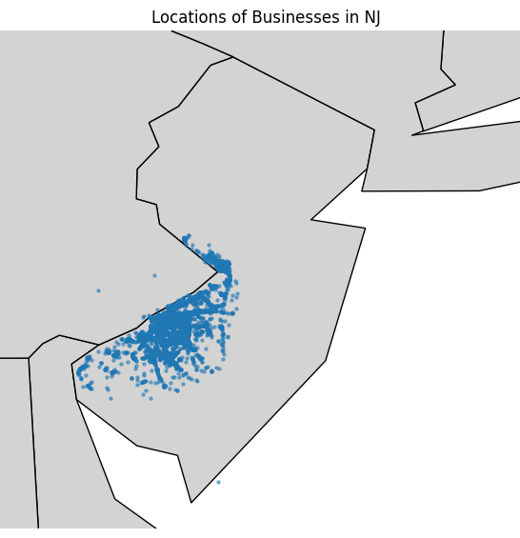
Yelp Dataset Missing Data
The Yelp dataset we intended to use does not have New York data—in fact it only contains a small sample of data even in the states present in the dataset (left)
The best sampled states were found to be Indiana (middle) and New Jersey (right), but there is insufficient data across even these states and so we abandoned the Yelp dataset
‹#› |

Slide 8
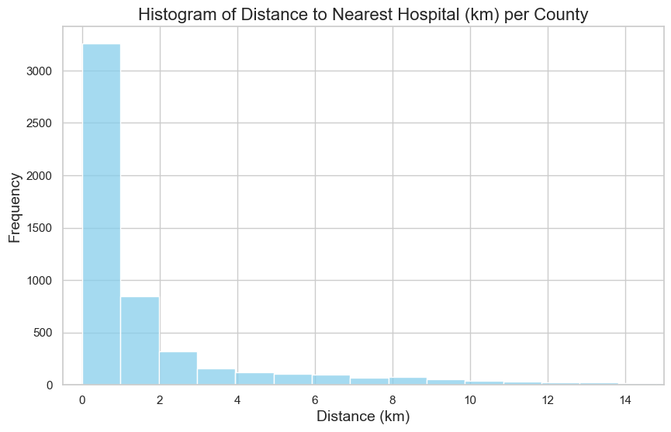
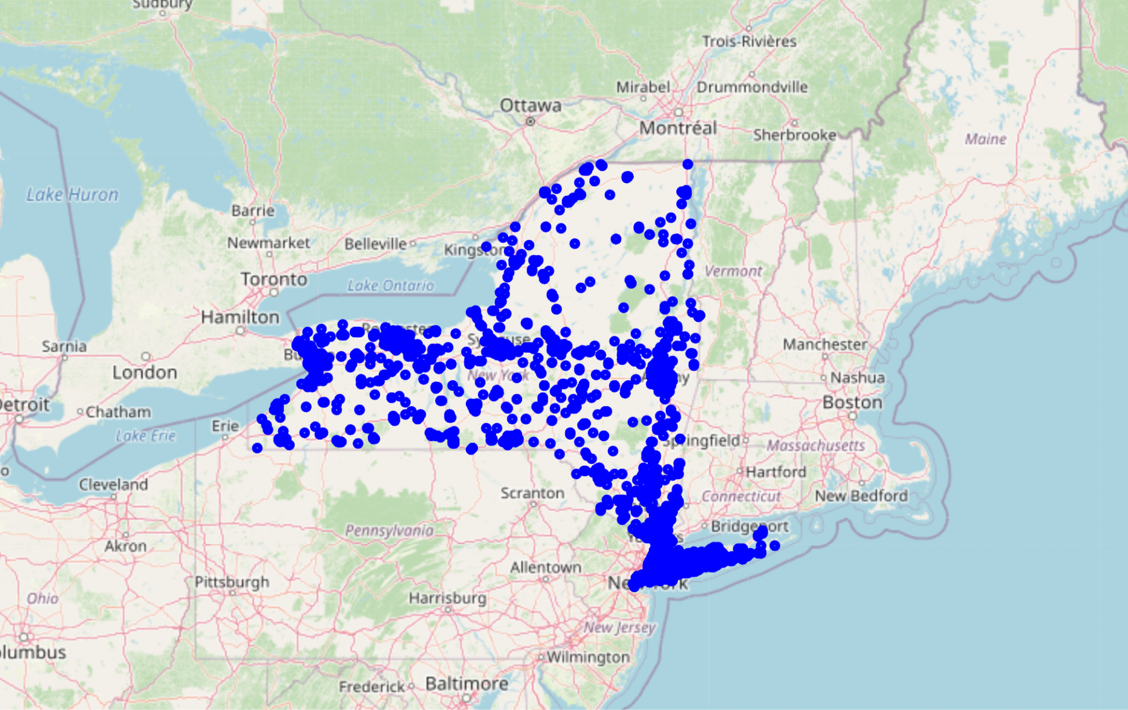
New York Hospitals Dataset
To replace the Yelp dataset, we decided to use government data on New York Hospitals, this data is not a sample and covers all of New York (left)
We then used the Haversine formula to engineer a feature: distance to nearest hospital (right)
This feature may simply be a proxy for indicating whether the county is urban or rural
New York Hospitals
‹#› |

Slide 9
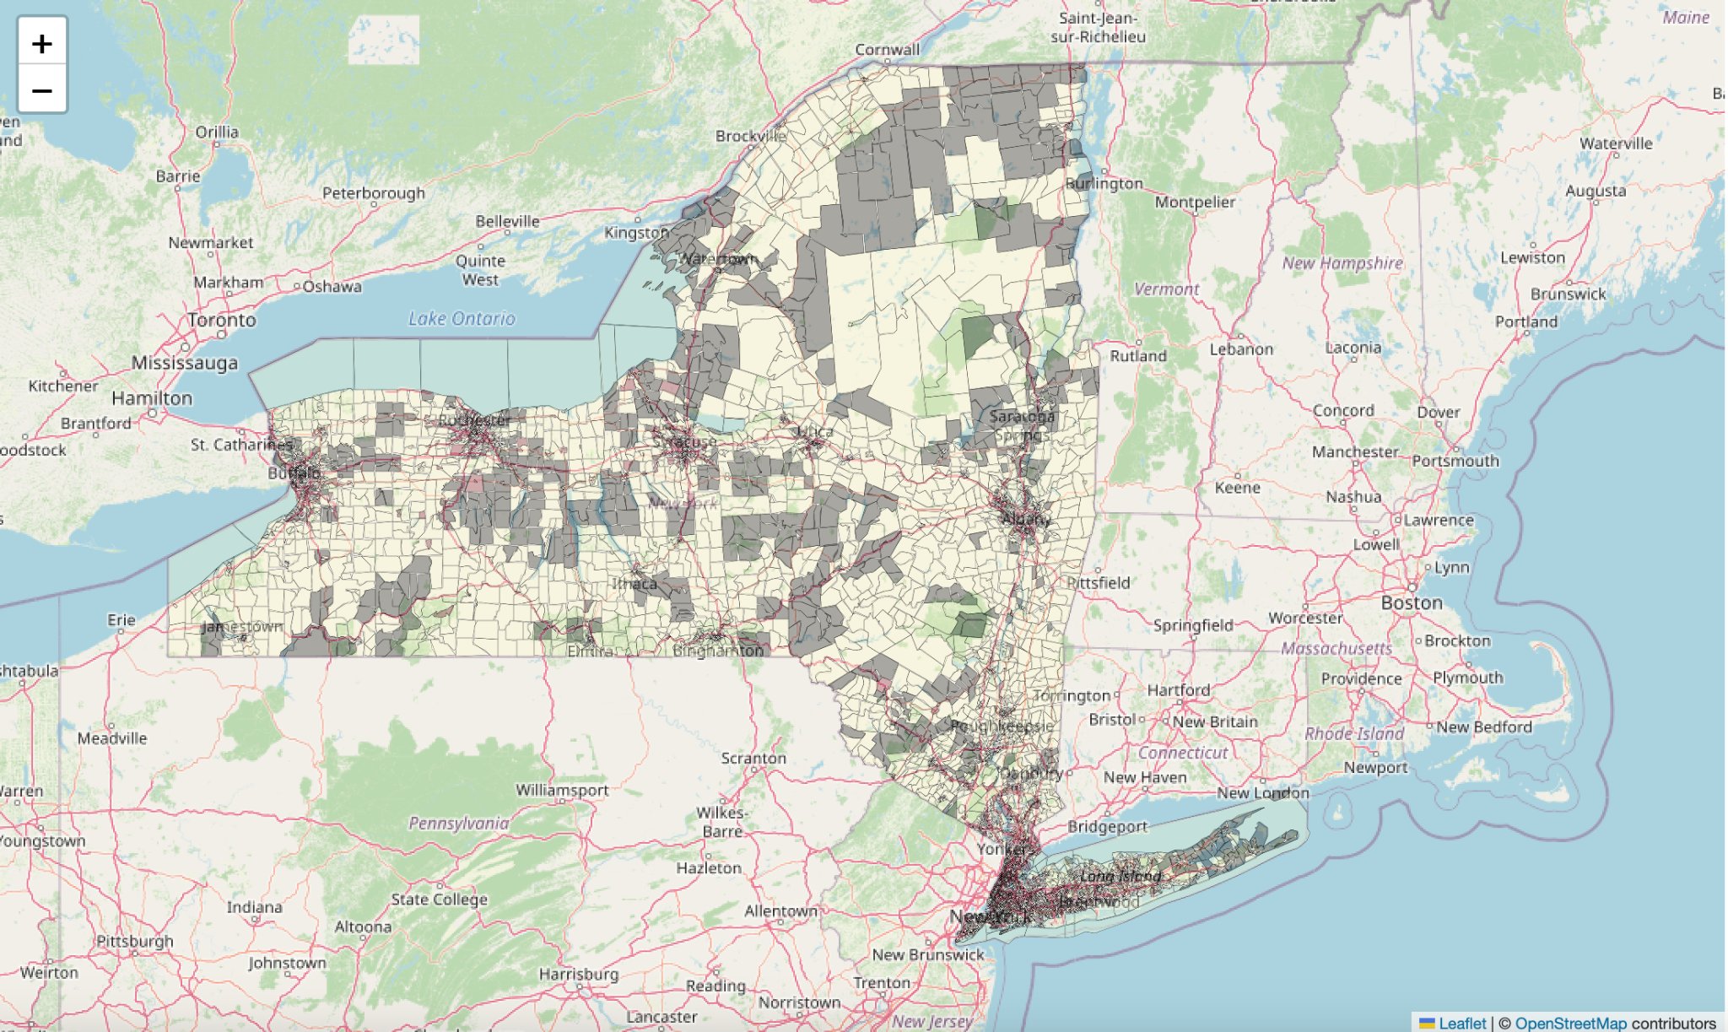
Smart Location Database Visualizations
Data Exploration
Filtered out the rows for ‘STATEEP=36’, data for NY state.
Merged the SLD data with Census Block Group boundaries shapefile.
Explored the data correlation.
Analyzed the density distribution both in heatmap and density plot.
Data Preprocessing
Checked missing value and filled them with the interpolation.
Initialize the scaler of MinMaxScaler and fit transform the data.
Visualized the density distribution both in heatmap and density plot.
The missing values in the grey polygons
‹#› |

Slide 10
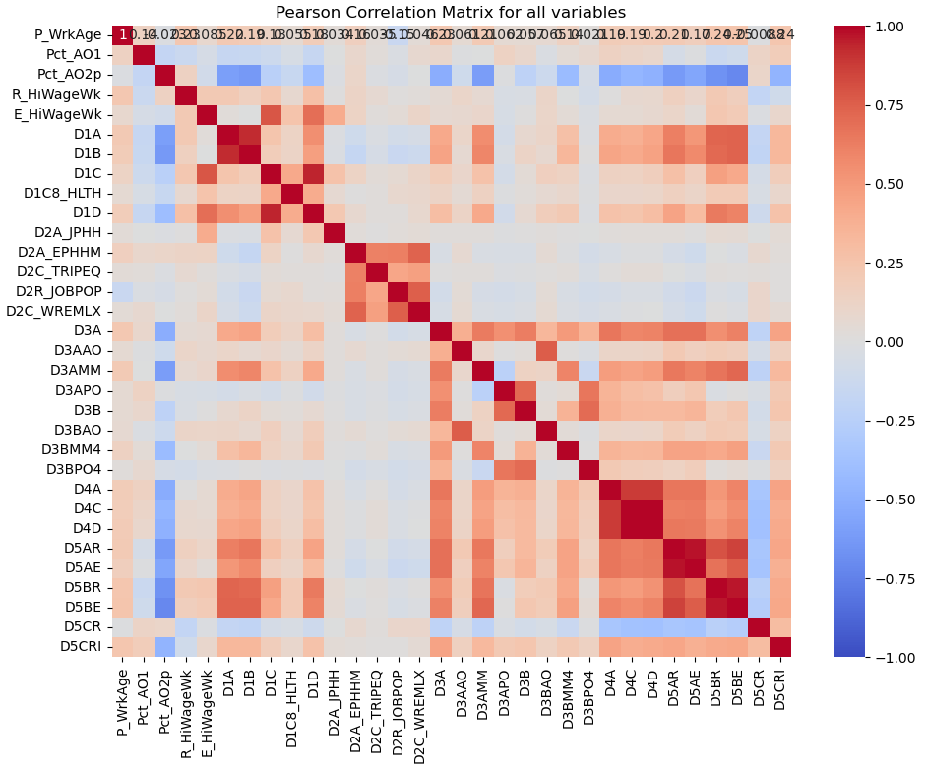
Smart Location Database Visualizations
Explored the data correlation
High correlation between ‘D1A’ and ‘D1B’; ‘D4A’ ,‘D4C’ and ‘D4D’; ‘D5AR’and ‘D5AE’; ‘D5BR’and ‘D5BE’.
D1a: Gross residential density (HU/acre) on unprotected land
D1b: Gross population density (people/acre) on unprotected land
D4a, Distance from the population-weighted centroid to nearest transit stop (meters) ,2020
D4c, Aggregate frequency of transit service within 0.25 miles of CBG boundary per hour during evening peak period, 2020
D4d, Aggregate frequency of transit service [D4c] per square mile
D5ar, Jobs within 45 minutes auto travel time, time- decay (network travel time) weighted, 2020
D5ae, Working age population within 45 minutes auto travel time, time-decay (network travel time) weighted
D5br , Jobs within 45-minute transit commute, distance decay (walk network travel time, GTFS schedules) weighted
D5be, Working age population within 45-minute transit commute, time decay (walk network travel time, GTFS schedules) weighted
We keep D1a, D4a, D4c, D5AR, D5BE from the above
‹#› |
Notes:
Removing highly correlated features

Slide 11
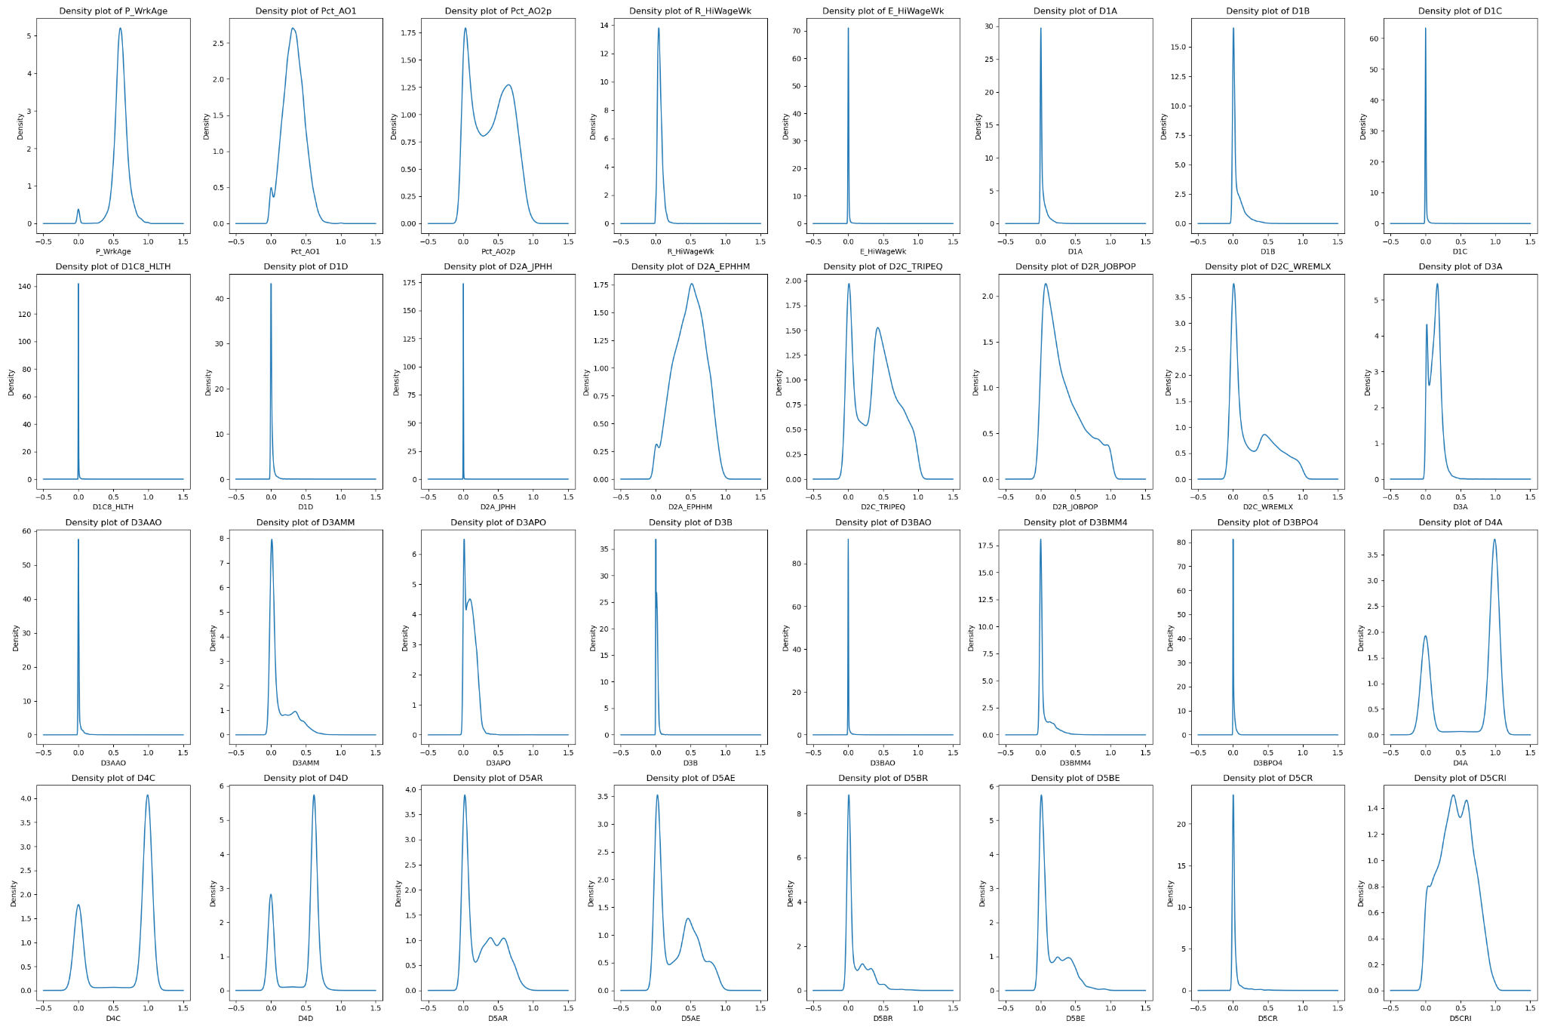
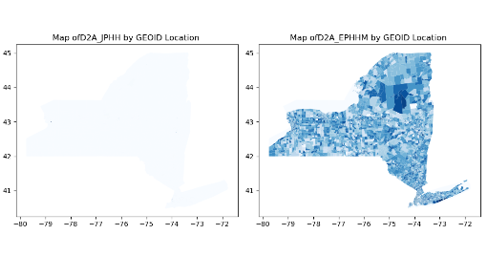
Smart Location Database Visualizations
Analyzed the density distribution both in heatmap and density plot
From the density map and plot, there are several features that are imbalanced, and with extremely large outliers. We remove the imbalanced features with most of zeros (looks empty in the density plot and signifies missing values). We finally filtered 18 features out of 33
Features kept
Features removed
Feature removed
Feature kept
‹#› |
Notes:
Dont need to show ALL of these, show a few examples of less populated fields

Slide 12
Proposed Models
Random Forest Regressor Purpose: Baseline model to explore interactions among variables. Strength: Interpretable feature importance, robust with complex datasets. | XGBoost (Gradient Boosting) Purpose: Provides accurate predictions by focusing on difficult cases. Strength: High performance on structured data with nonlinear relationships.
Geographically Weighted Regression (GWR) Purpose: Models spatial variations by allowing local adjustments to predictors. Strength: Reveals geographic trends; captures community-specific influences. | Feedforward Neural Network Purpose: Captures complex, nonlinear patterns across all predictors. Strength: Flexible in detecting hidden relationships across high-dimensional data.
‹#› |

